Slide 1
A compilation technique to increase X3D performance and safety
Giuseppe Maggiore, Fabio Pittarello, Michele Bugliesi, Mohamed Abbadi
Università Ca’ Foscari di Venezia Dipartimento di Scienze Ambientali, Informatica e Statistica
{maggiore,pitt,michele,mabbadi}@dais.unive.it

Slide 2
Agenda
Performance and safety in modern X3D browsers
Performance as a compilation problem
Safety as a meta-programming problem
Future work – in the past!

Slide 3
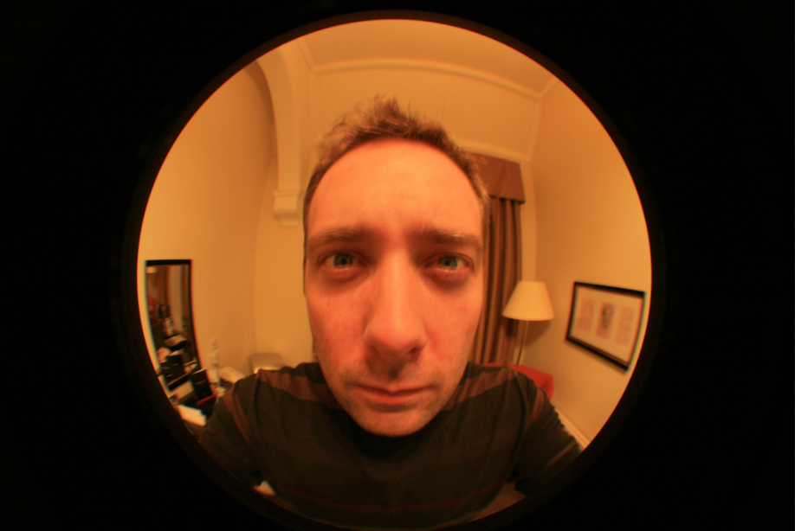

Disclaimer
I am a game developer
Warped perspective on VR/CHI ☺

Slide 4
VR requirements
Virtual reality needs
Performance (smooth feeling, real time)
Complexity (interest and richness of the simulation)

Slide 5
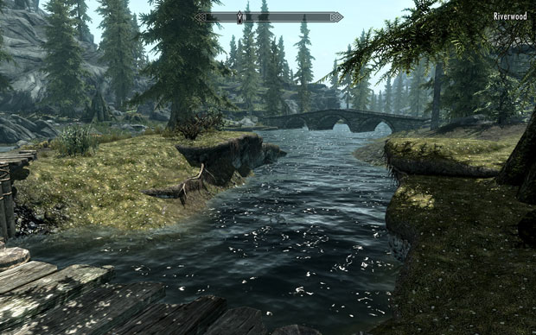
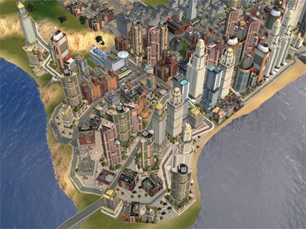
VR complexity
Visual (beauty, realism)
Logical (articulated response, believable entities)

Slide 6
Tradeoff
More complex is better?
More complex is also slower!
Today we fight this ☺

Slide 7
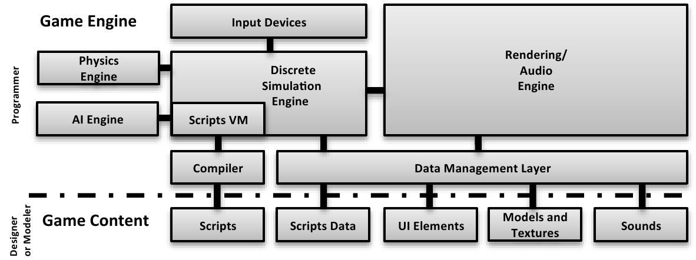
Data-driven browsers/engines
General purpose
Custom scene + scripts
Very flexible

Slide 8

Data-driven browsers/engines
Keep designers and programmers apart ☺

Slide 9
Performance problem
Too flexible equals
Granular dynamic dispatching (reading an object position goes through a vtable: poor cache!)
Dynamically accessing the scene through scripts

Slide 10
Removing dynamic dispatching
Do we need so much flexibility?
Nope
Large parts of a scene are static (both entities/nodes and logic/routes)

Slide 11
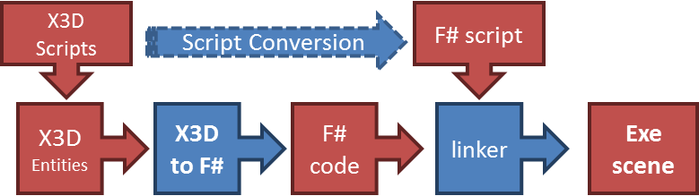
Compiling X3D
Instead of interpreting X3D, we compile from it into “one browser per scene”

Slide 12
Sample scene
<Scene>
<ColorInterpolator DEF='myColor'
keyValue='1 0 0, 0 1 0, 0 0 1, 1 0 0'
key='0.0 0.333 0.666 1.0'/>
<TimeSensor DEF='myClock' cycleInterval='10.0' loop='true'/>
<Shape>
<Box/>
<Appearance>
<Material DEF='myMaterial'/>
</Appearance>
</Shape>
<ROUTE fromNode='myClock' fromField='fraction_changed'
toNode='myColor' toField='set_fraction'/>
<ROUTE fromNode='myColor' fromField='value_changed'
toNode='myMaterial' toField='diffuseColor'/>
</Scene>

Slide 13
Scene type
type Scene = {
myColor : ColorInterpolator
myClock : TimeSensor
myMaterial : Material
dynamic_nodes : List<Node>
script : Script
}

Slide 14
Init
let scene =
let myColor = ColorInterpolator(keyValue = [ ... ], key = [ ... ])
let myClock = TimeSensor(cycleInterval = 10.0, loop = true)
let myMaterial = Material()
let dynamic_nodes =
[Shape(Value = Box(Appearance(Value = myMaterial)))]
{
myColor = myColor
myClock = myClock
myMaterial = myMaterial
dynamic_nodes = dynamic_nodes
script = null
}

Slide 15
Tick
let update dt =
scene.myClock.update dt
scene.myColor.update dt
scene.myMaterial.update dt
for node in scene.dynamic_nodes do
node.update dt
scene.script.update dt
myColor.fraction <- myClock.fraction
myMaterial.diffuseColor <- myColor.value

Slide 16
Is this faster?
Test
Octaga (300 shapes) | 340
Octaga (680 shapes) | 150
BS Contact (300 shapes) | 300
BS Contact (680 shapes) | 145
Ours (300 shapes) | 510
Ours (680 shapes) | 224

Slide 17
Scripts
Am I the only one who finds this ugly?
Unsafe (strings, casts!)
Slow (lookups, reflection)
X3DNode myClock = mainScene.getNamedNode("myClock");
SFTime time = (SFTime)myClock.getField("time");

Slide 18
Scripts
Linking statically to the previous application
Scripts as data
Safety
Static lookups to nodes when possible
Dynamic lookups to nodes when needed
Implemented as monads and coroutines

Slide 19

Monads?!?

Slide 20
Monads?!?
No details here, don’t worry ☺
Just know that monads are great ways to express custom computations

Slide 21
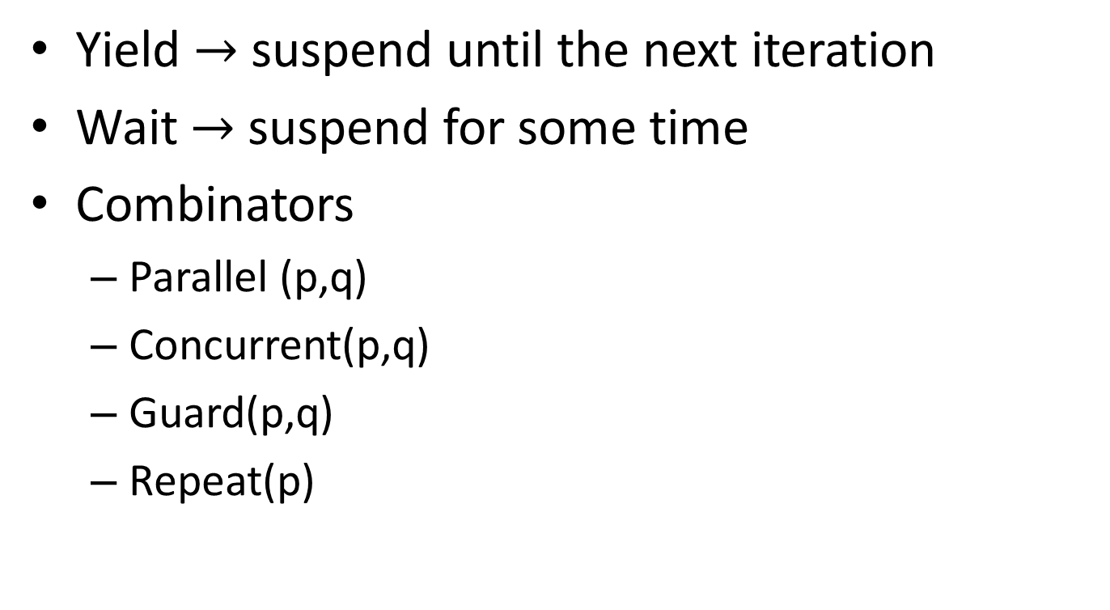
F# Scripts
Yield $→$ suspend until the next iteration
Wait $→$ suspend for some time
Combinators
Parallel (p,q)
Concurrent(p,q)
Guard(p,q)
Repeat(p)

Slide 22
Simple Script
let my_script (scene:Scene) =
let rec animate =
script {
if scene.myBox.Position.Y < 100.0f then
scene.myBox.Position.Y <- scene.myBox.Position.Y + 0.1f
do! animate }
guard
script { return inside(scene.Camera.Position, myRegion) }
animate

Slide 23
Is this faster?
Language | Test1 | Test2 | Test3
F# | 7.6 | 5.8 | 4.0
C# | 7.1 | 4.2 | 4.1
Lua | 1.5 | 1.4 | 0.8
Python | 1.1 | 1.1 | 0.9
Higher is better (millions of ticks per second)

Slide 24
Future work
Casanova
Fully-fledged language
Based on F#
For making games/interactive applications
Routes (rules), scripts, world model, etc.
RSD
Design pattern for games/interactive applications
Routes (rules), scripts, world model, etc.

Slide 25
Conclusions
Compiling is faster than interpreting
Still in this day and age
Faster code allows
More entities
More visual effects
Static + dynamic scene
Static when possible
Dynamic when needed
Scripts as meta-programs
Fast
Expressive

Slide 26
This is IT!
Thank you

